Slide 1

Digital Image Processing
Course Project

Slide 2


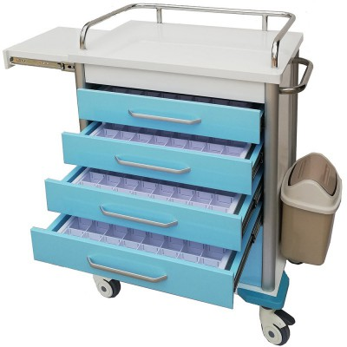
Background
Autonomous drug delivery vehicle
Taking
Delivering

Slide 3
Content
Taking
Follow the lane lines, then turn in the direction indicated (left or right) according to the type of medication on the sign at the T-junction.
Content
Delivering
Drive the robot through 3 traffic cones. Then recognize the position of the nurse (an image) and drive the robot to follow it.

Slide 4
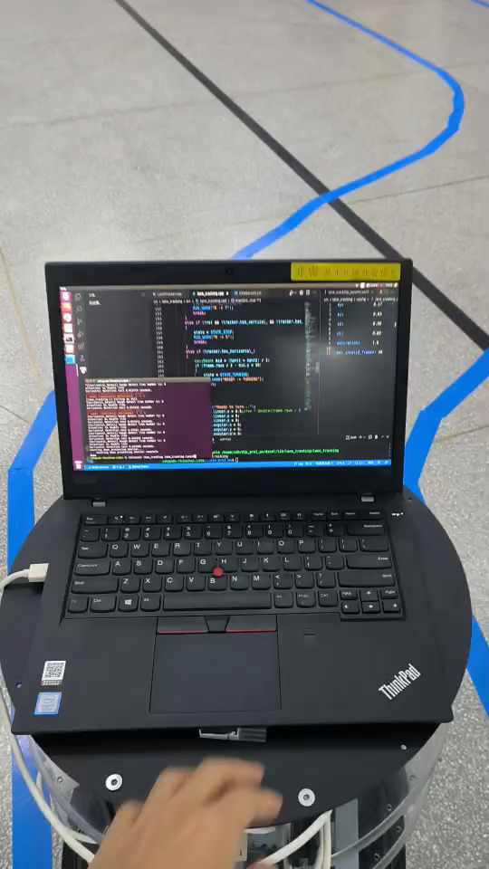
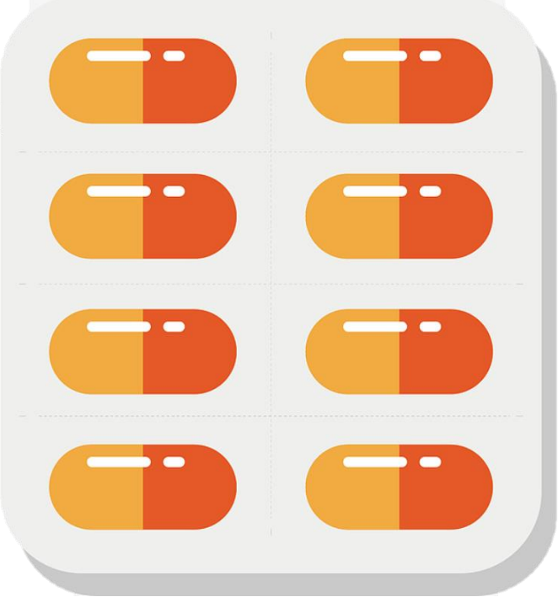

Taking
Tracking the lane lines to the T-junction.
Identify the type of medication on the sign at the junction and turn in the direction indicated and continue to follow the lane.
Turn left
Turn right

Slide 5
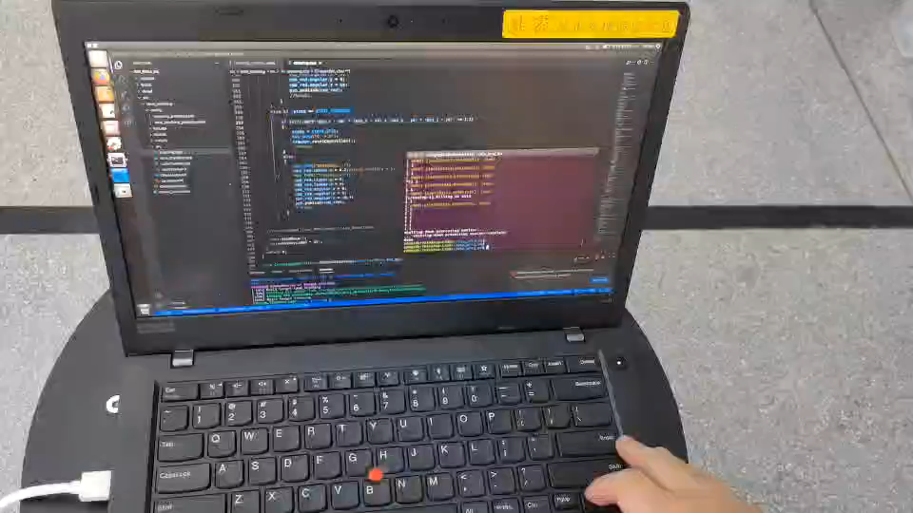
Delivering
Cross the cones (2 red, 1blue) and go around the back of the blue cone.

Slide 6
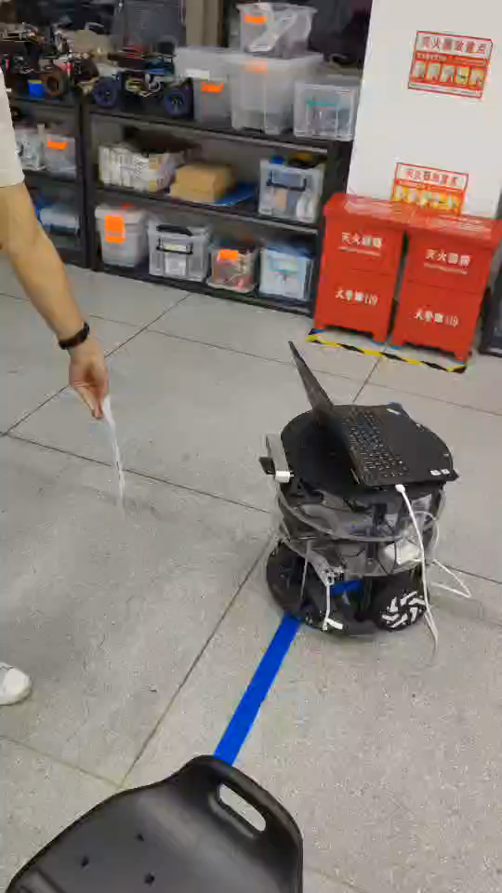

Delivering
Follow the nurse, keeping the distance and the direction.

Slide 7
Key Technology
Search
Collect information in unfamiliar environments
Key Technology
Detection
Mark detected accurately
Motion
Control the robot to complete the task

Slide 8


Request
Demonstration
Project Report
Project Code

Slide 9
Request
Demonstration评分标准（按百分制）
题目1
不出线走到路口50
正确拐弯70
拐弯后恢复巡线状态80
行驶平稳 方向跟随性好 快速流畅 等80+
题目2
穿越障碍并绕到蓝色锥后方50
跟随70
穿越后无人为干预自动跟随80
快速流畅 识别抗干扰性好跟随好80+
总分占比（满分100分）
实操65分
报告20分
答辩15分

